Slide 1




Presenting Partners:
Notes:
9:00

Slide 2

Our Mission:
Collaborate to propose viable, sustainable solutions to specific environmental problems in our communities.
Identify and leverage the mindsets, strategies and supports that will allow us to innovate in a variety of contexts.
#greenHACK
Notes:
Handout a copy of the schedule

Slide 3
Today:
The Entrepreneurial Mindset
Environmental Problems as Opportunities
Building Your Start-up Team
Empathy & Need Finding
Ideation Tools
Rapid Prototyping
Business Model Basics
#greenHACK
Notes:
Handout a copy of the schedule

Slide 4
Tomorrow:
Business Model Canvas (supplemental)
Open-ended Design and Prep Time
Pitch Techniques
3:30pm – PITCH COMPETITION
#greenHACK

Slide 5


Pitch Competition
1. Problem
Who, specifically, is affected?
Why is this important to solve?
2. Solution
Meets needs of a specific audience
Creatively visualized with a prototype
3. Business Model
Clear, compelling value proposition
Viable and sustainable
2 minutes to pitch
+
3 minutes for questions

Slide 6
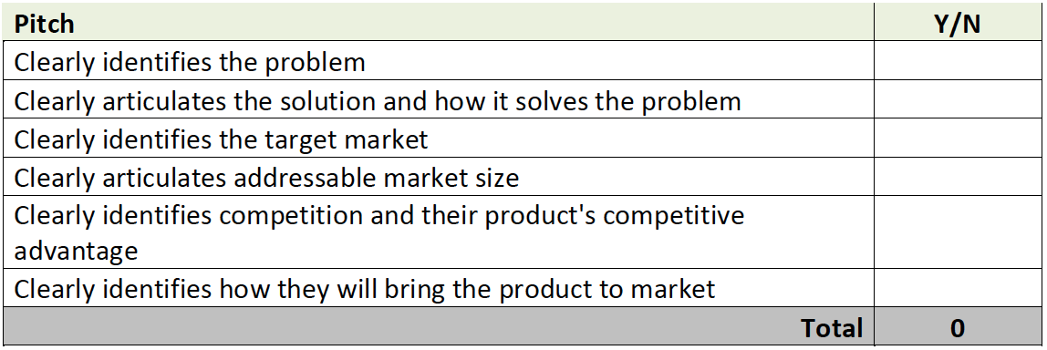
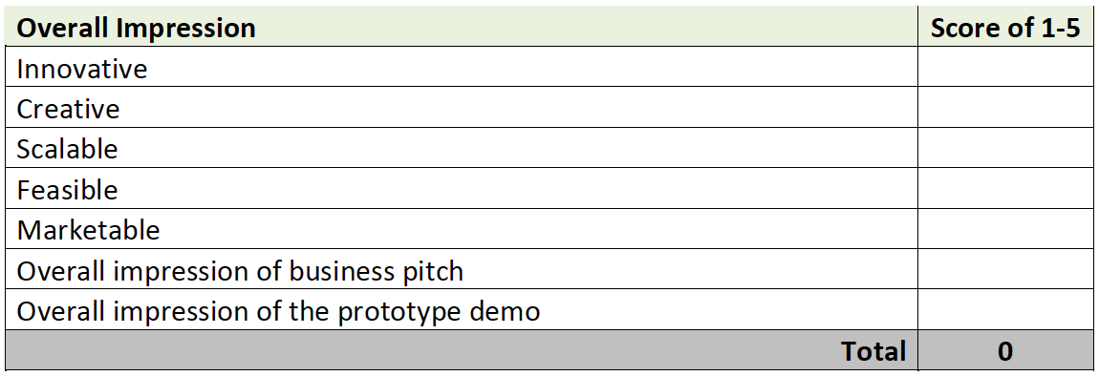
Pitch Assessment

Slide 7
The Entrepreneurial Mindset is…
the ability to find opportunities in unexpected places.
#greenHACK

Slide 8
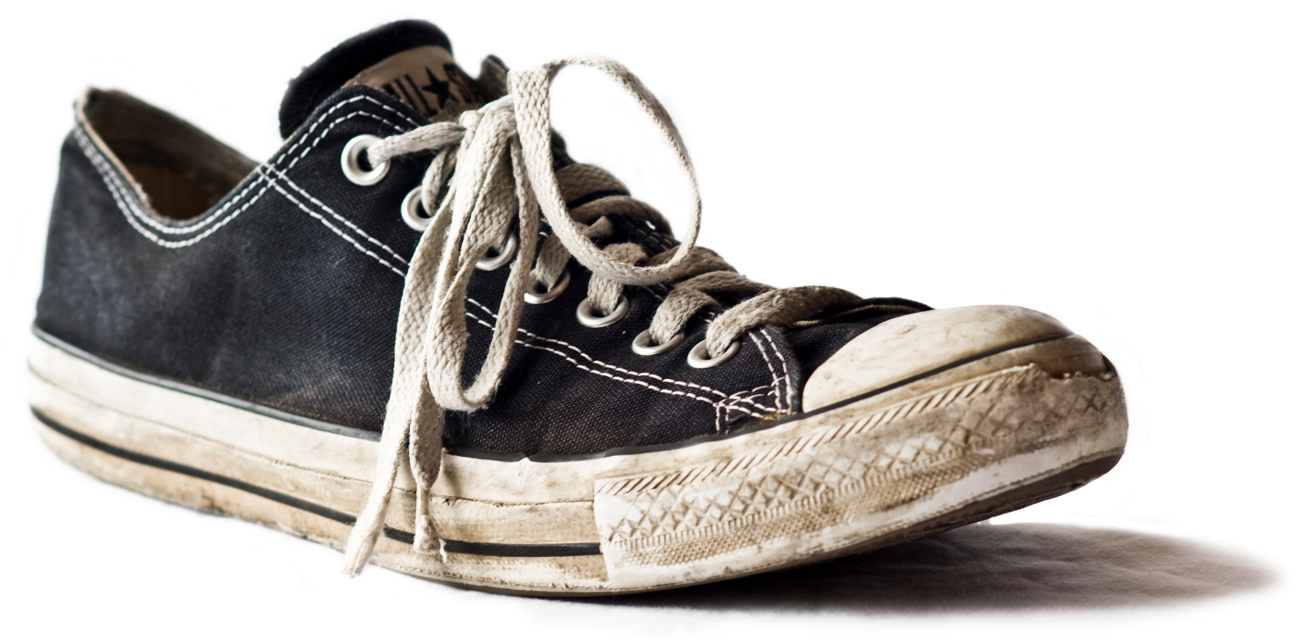
What can this be used for?
#greenHACK
Notes:
What can this be used for?
This is an activity that is used to measure creativity.

Slide 9
You have 60 seconds
#greenHACK

Slide 10

Let’s Share!
What could you use a shoe for?
#greenHACK

Slide 11
Switch Groups!
Let’s try on some new collaborators
#greenHACK

Slide 12
What environmental problems could you address with this?
#greenHACK
Notes:
What can this be used for?
This is an activity that is used to measure creativity.

Slide 13
- 5 mins -
Audience
Who will you help?
Problem
What will you help them overcome?
Solution
How will you help them?
#greenHACK
Notes:
What can this be used for?
This is an activity that is used to measure creativity.

Slide 14
Let’s Share!
What environmental problems can you address with a shoe?
Who are you helping?
#greenHACK

Slide 15
Environmental Problems…
are opportunities to innovate.
#greenHACK
Notes:
9:30

Slide 16
Some “seed” challenges…
Rethinking Recycling
Busch Systems – how can we recycle e-vapes?
#greenHACK
Notes:
9:30

Slide 17


Welcomes:

Slide 18

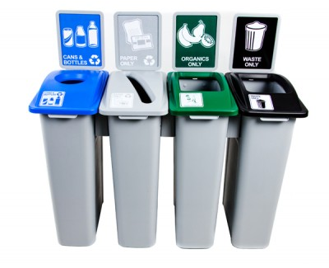
Background
Craig Busch founded Busch Systems as a student at York U.
Busch Systems started out producing blue boxes in 1985.
Operating out of Barrie, Busch serves the North American market.
Serves government, institutional and corporate customers.
By 1990 Busch supplied 50% of the blue boxes used in Canada.

Slide 19

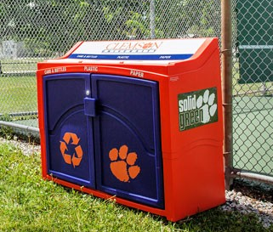
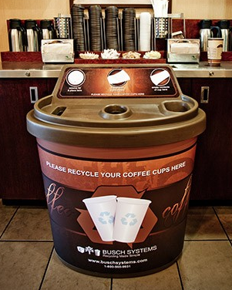

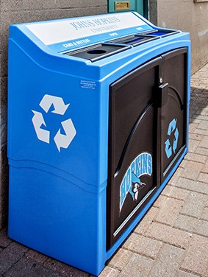
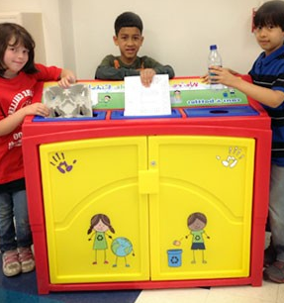

Slide 20
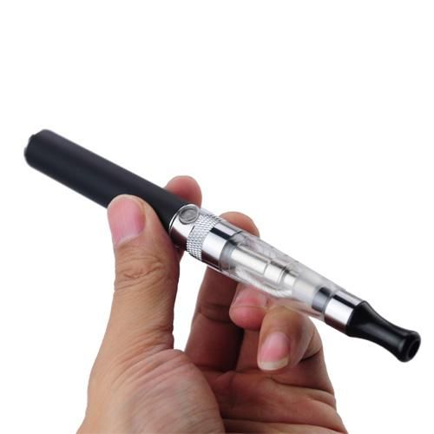
The problem with e-vapes
As e-cigarettes continue to become more popular, single-use items such as cartomizers and disposable e-cigarettes take up an increasing amount of landfill space.

Slide 21
The scale of the problem
There are 2.1 million e-cigarette users in the UK, 9 million in the U.S. and 1.9 million in Canada.
About 3.7 percent of adults used e-cigarettes every day or some days. Usage trends to 18-30 crowd.
Many e-cigarette users believe that the devices are disposable. They contain many recyclable and toxic materials.

Slide 22
Your Challenge:
Develop a universal solution to capture e-vapes for recycling.
What would an e-vape recycling service or container look like?

Slide 23
Some “seed” challenges…
Rethinking Recycling
Busch Systems – how can we recycle e-vapes?
Green Space Design
Lakehead – how can we reduce the carbon footprint of the campus?
#greenHACK
Notes:
9:30

Slide 24

Welcomes:

Slide 25
Background
Lakehead’s campus serves over 1,400 students in their downtown and University Avenue sites.
The University Avenue campus is the first in North America to be entirely built to Leadership in Energy and Environmental Design (LEED) certification standards.
Over 50% of the roof is covered with a natural ground cover, which acts as a cooling agent and helps manage runoff.
The building also uses a geothermal heating system.

Slide 26
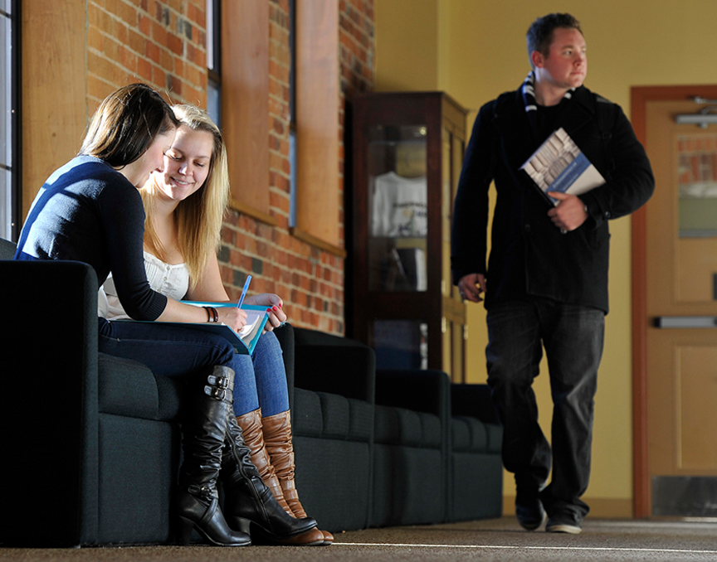
Your Challenge:
How can we further reduce our carbon footprint on campus?
Textbooks
E-waste
Food waste
Power consumption

Slide 27
Some “seed” challenges…
Transportation Solutions
GEEP – how do we more efficiently transport e-waste such as “button batteries”?
#greenHACK
Notes:
9:30

Slide 28

Welcomes:
Responsible. Sustainable. Secure.

Slide 29
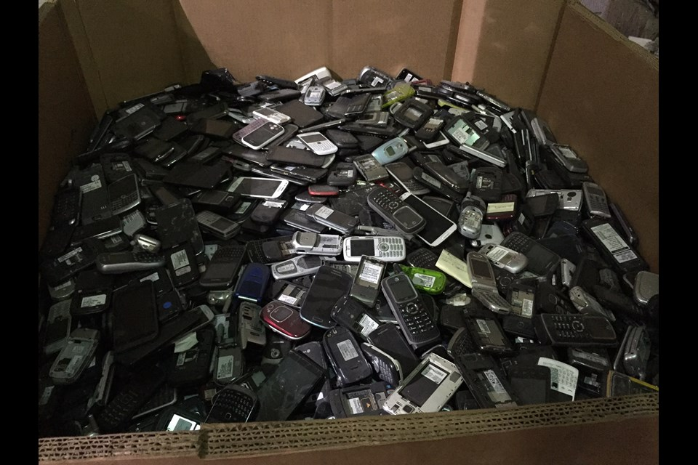
Background
Barrie company that “de-manufactures” electronic waste….almost 100%
Data secure refurbishing and asset remarketing
Safe, secure reuse and recycling of waste electric and electronic equipment (WEEE)
130 million pounds of e-waste yearly

Slide 30

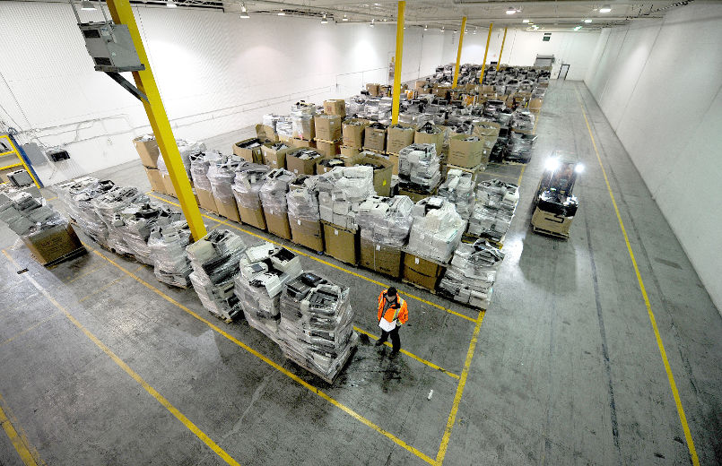
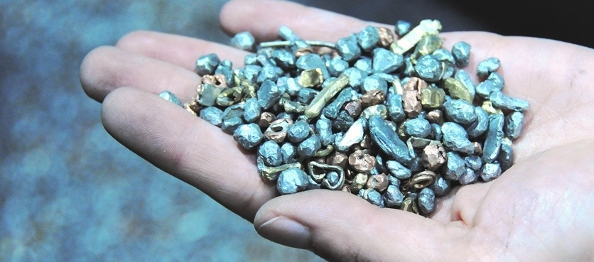
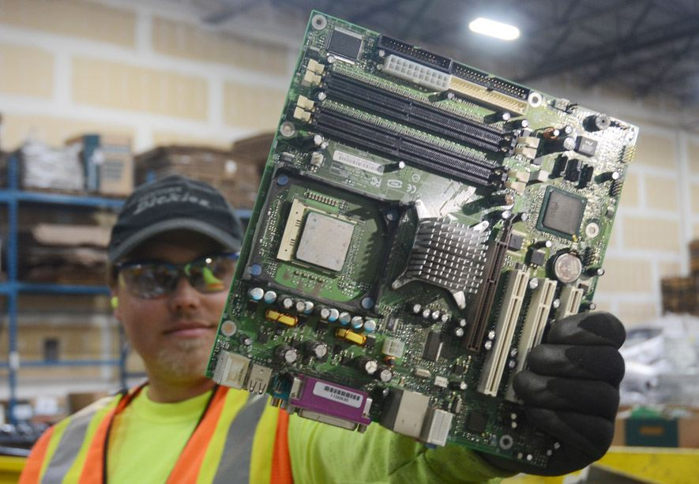

Slide 31
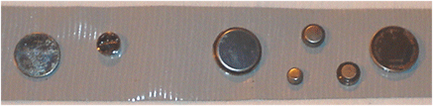
The Problem with “Button Batteries”
Used in watches, hearing aids, toys, and remote controls.
May containing Alkaline manganese, Mercuric oxide, Zinc, Silver oxide, Lithium
To transport them, they are extracted by hand and taped to prevent arcing and fires while shipping.
The process is labour intensive and “old school”.

Slide 32
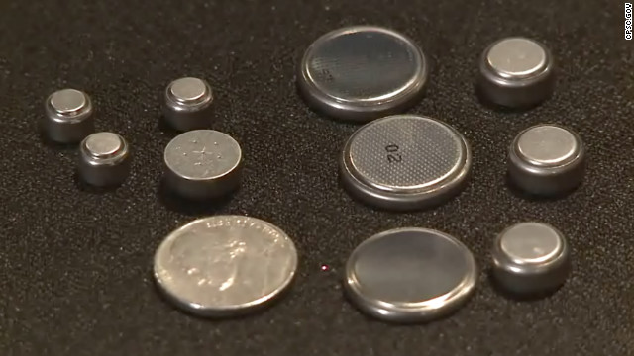
Your Challenge:
Develop a method to secure and ship the button batteries that is cheap, safe, and simple.

Slide 33
Some “seed” challenges…
Transportation Solutions
GEEP – how do we more efficiently transport e-waste such as “button batteries”?
Green “Nudging”
greenHACK – what small changes can we encourage people to make that would have large environmental benefits?
#greenHACK
Notes:
9:30

Slide 34

Let’s crowdsource a few more…
Propose an environmental challenge or question you’d like help solving at greenHACK
(in 30 seconds or less)
#greenHACK
Notes:
9:30

Slide 35
Building Your Start-up Team
#greenHACK
Notes:
9:30

Slide 36
Step 1:
Find people with common goals
#greenHACK

Slide 37
Screen
Rethinking Recycling
Green Space Design
Crowdsourced Challenges
Transportation Solutions
Green “Nudging”
#greenHACK

Slide 38
Step 2:
Find people with diverse skillsets
#greenHACK

Slide 39
What do you bring to a team?
HACKERS
HUSTLERS
DESIGNERS
Enjoy building things
Comfortable using and learning new technologies
Finds unexpected uses for materials
Enjoy presentations
Good at coming up with clear, compelling arguments
Tailors communication to the needs of the audience
Enjoy problem solving
Good listener who builds off of the ideas of collaborators
Considers multiple ways to solve problems
#greenHACK

Slide 40
Let’s Network!
Over the next 10 minutes, talk to 3 – 5 people
with a different colour than you
HACKER
HUSTLER
DESIGNER
What attracted you to this problem?
What makes you a hacker, hustler, or designer?
#greenHACK
Notes:
10 minutes

Slide 41
What was challenging about the networking we just did?
What will you do differently next time?
#greenHACK
Notes:
A pivot is a “change in strategy without a change in vision”. Entrepreneurial people are constantly pivoting the language they use to describe themselves in order to better communicate their value to potential collaborators.
Based on your experiences with the activity so far, what could you do to improve how you present your personal brand? For example:
Perhaps you’re a hacker rather than a hustler…
Maybe you need to change some of the words you use to describe yourself…
Perhaps you need more or different evidence to support and explain your brand

Slide 42
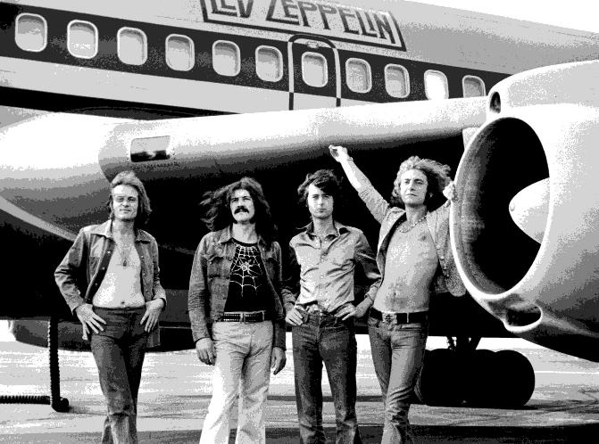
Form your start-up!
3 – 5 people with similar interests, but different skill sets.
#greenHACK
Notes:
Led Zeppelin rose to dominate 1970s rock music because each member of the band brought something unique to the whole. Students need to approach collaboration with that same mindset.

Slide 43
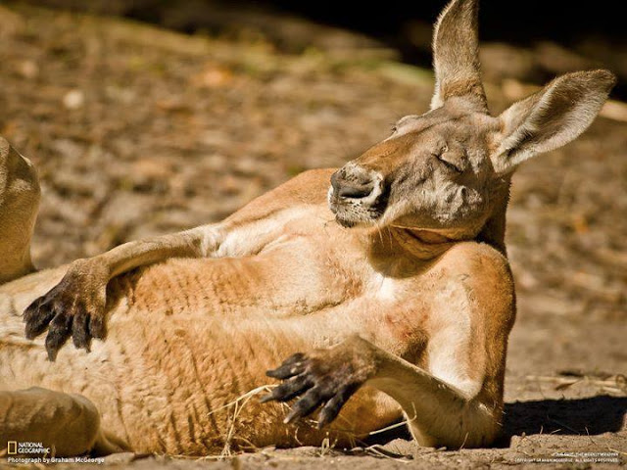
Let’s start again at 11:00
Notes:
When everyone comes back, they will be in their school groups.

Slide 44
Empathy & Need Finding
#greenHACK
Notes:
9:30

Slide 45
Empathy
“The art of stepping imaginatively into the shoes of another person, understanding their feelings and perspectives and using that understanding to guide your actions.”
-Roman Krznaric
#greenHACK
Notes:
9:30

Slide 46
Empathy
“The art of stepping imaginatively into the shoes of another person, understanding their feelings and perspectives and using that understanding to guide your actions.”
-Roman Krznaric
#greenHACK
Notes:
9:30

Slide 47

Who buys milkshakes?
#greenHACK
Notes:
9:30

Slide 48
What’s the Lesson?
#greenHACK
Notes:
9:30

Slide 49
Who faces the problem you’re looking to address?
What consequences does this problem have for them?
How are they currently dealing with this problem?
What is effective & ineffective about their current solution?
Where can we find answers to these questions?
#greenHACK
Notes:
9:30

Slide 50

It’s lunch o’clock!
We’ll start again at 1:00
#greenHACK
Notes:
9:30

Slide 51
Ideation Tools
#greenHACK
Notes:
9:30

Slide 52
Look for root causes with “Causal Modelling”
Why?
Why?
PROBLEM
Why?
Why?
Why?
Why?
Why?
Why?
Why?
Why?
Why?
Why?
#greenHACK

Slide 53
Build off of and improve what already exists
Existing Solutions
What if…
#greenHACK

Slide 54
Identify 2 – 4 solutions to develop further
Existing Solutions
What if…
Does the solution have a clear audience in mind?
Does the solution have clear advantages over existing solutions?
Does the solution address the root of the problem?
#greenHACK

Slide 55
What is needed to execute these solutions?
#greenHACK

Slide 56
How will you test these potential solutions before investing too heavily in them?
#greenHACK

Slide 57
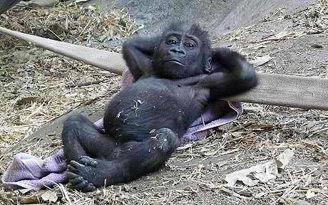
Let’s start again at 3:00
Notes:
When everyone comes back, they will be in their school groups.

Slide 58
Rapid Prototyping
#greenHACK
Notes:
9:30

Slide 59
What is the purpose of a prototype?
#greenHACK

Slide 60
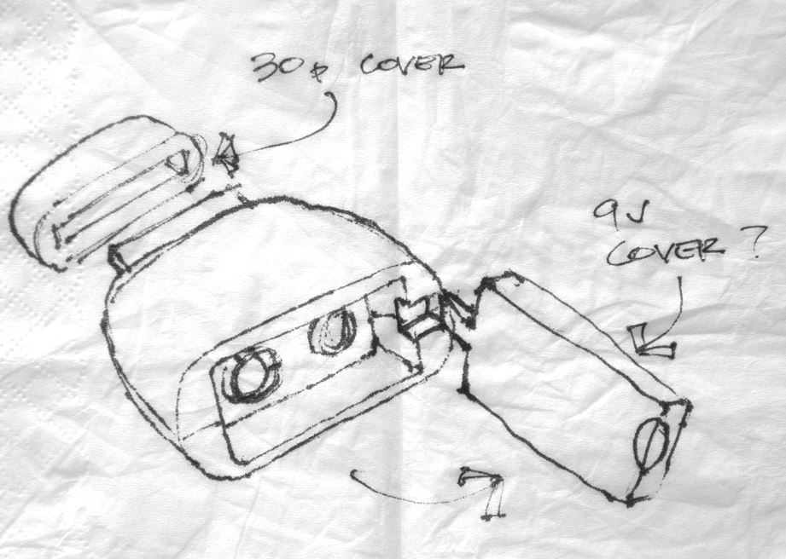
Prototyping Physical Products
What does your user want to accomplish?
What key features do they need to accomplish this?
How will users interact with this solution?
#greenHACK

Slide 61
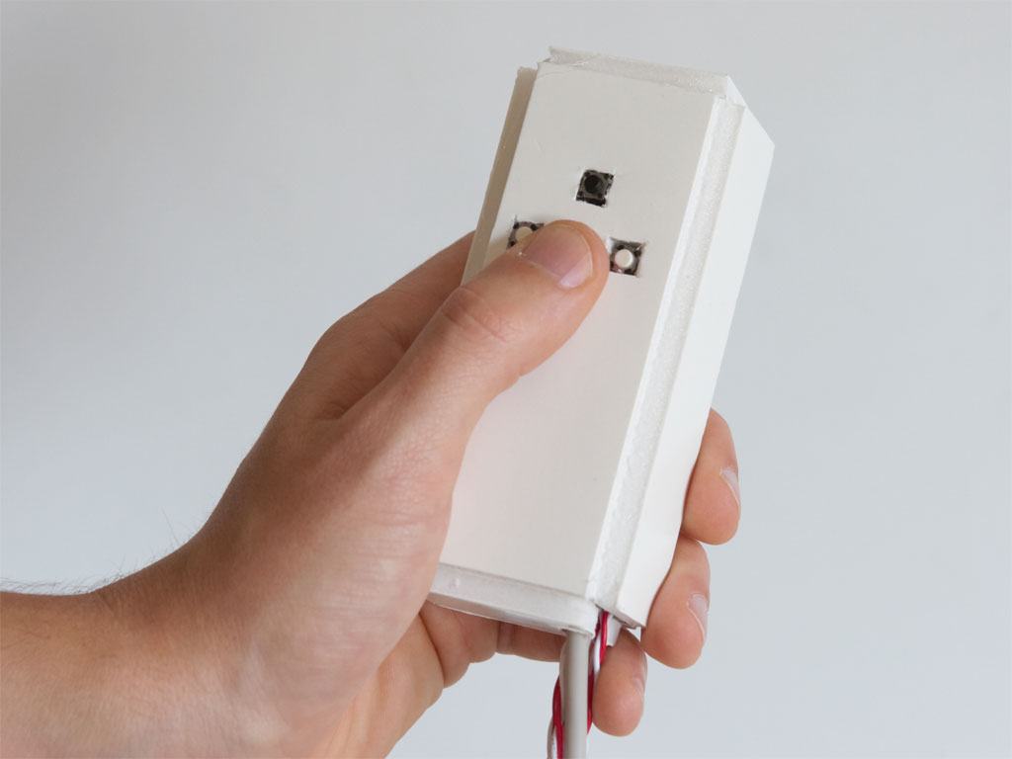
Prototyping Physical Products
What does your user want to accomplish?
What key features do they need to accomplish this?
How will users interact with this solution?
#greenHACK

Slide 62
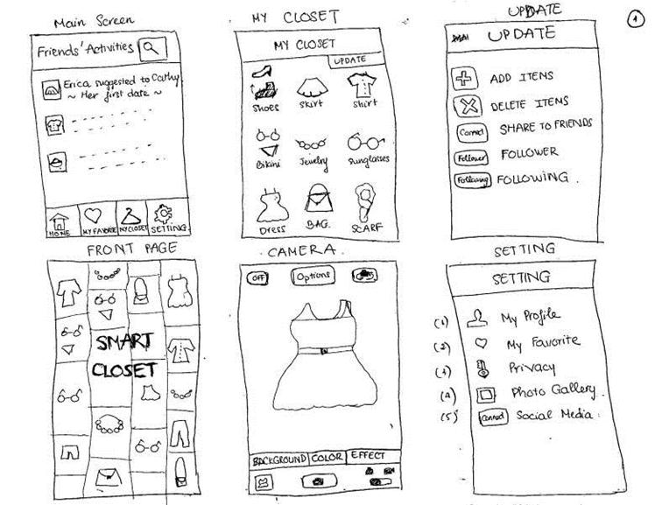
Prototyping Apps & Websites
What does your user want to accomplish?
What key features do they need to accomplish this?
How will users interact with this solution?
#greenHACK

Slide 63
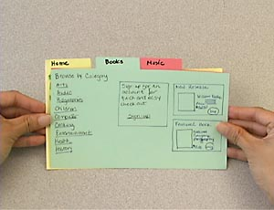
Prototyping Apps & Websites
What does your user want to accomplish?
What key features do they need to accomplish this?
How will users interact with this solution?
#greenHACK

Slide 64
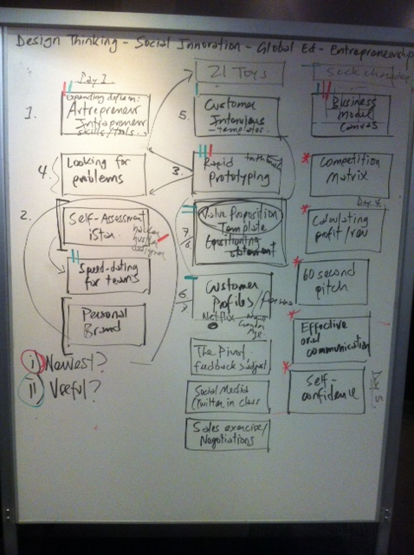
Prototyping Presentations & Pitches
What does your user want to accomplish?
What key features do they need to accomplish this?
How will users interact with this solution?
#greenHACK

Slide 65
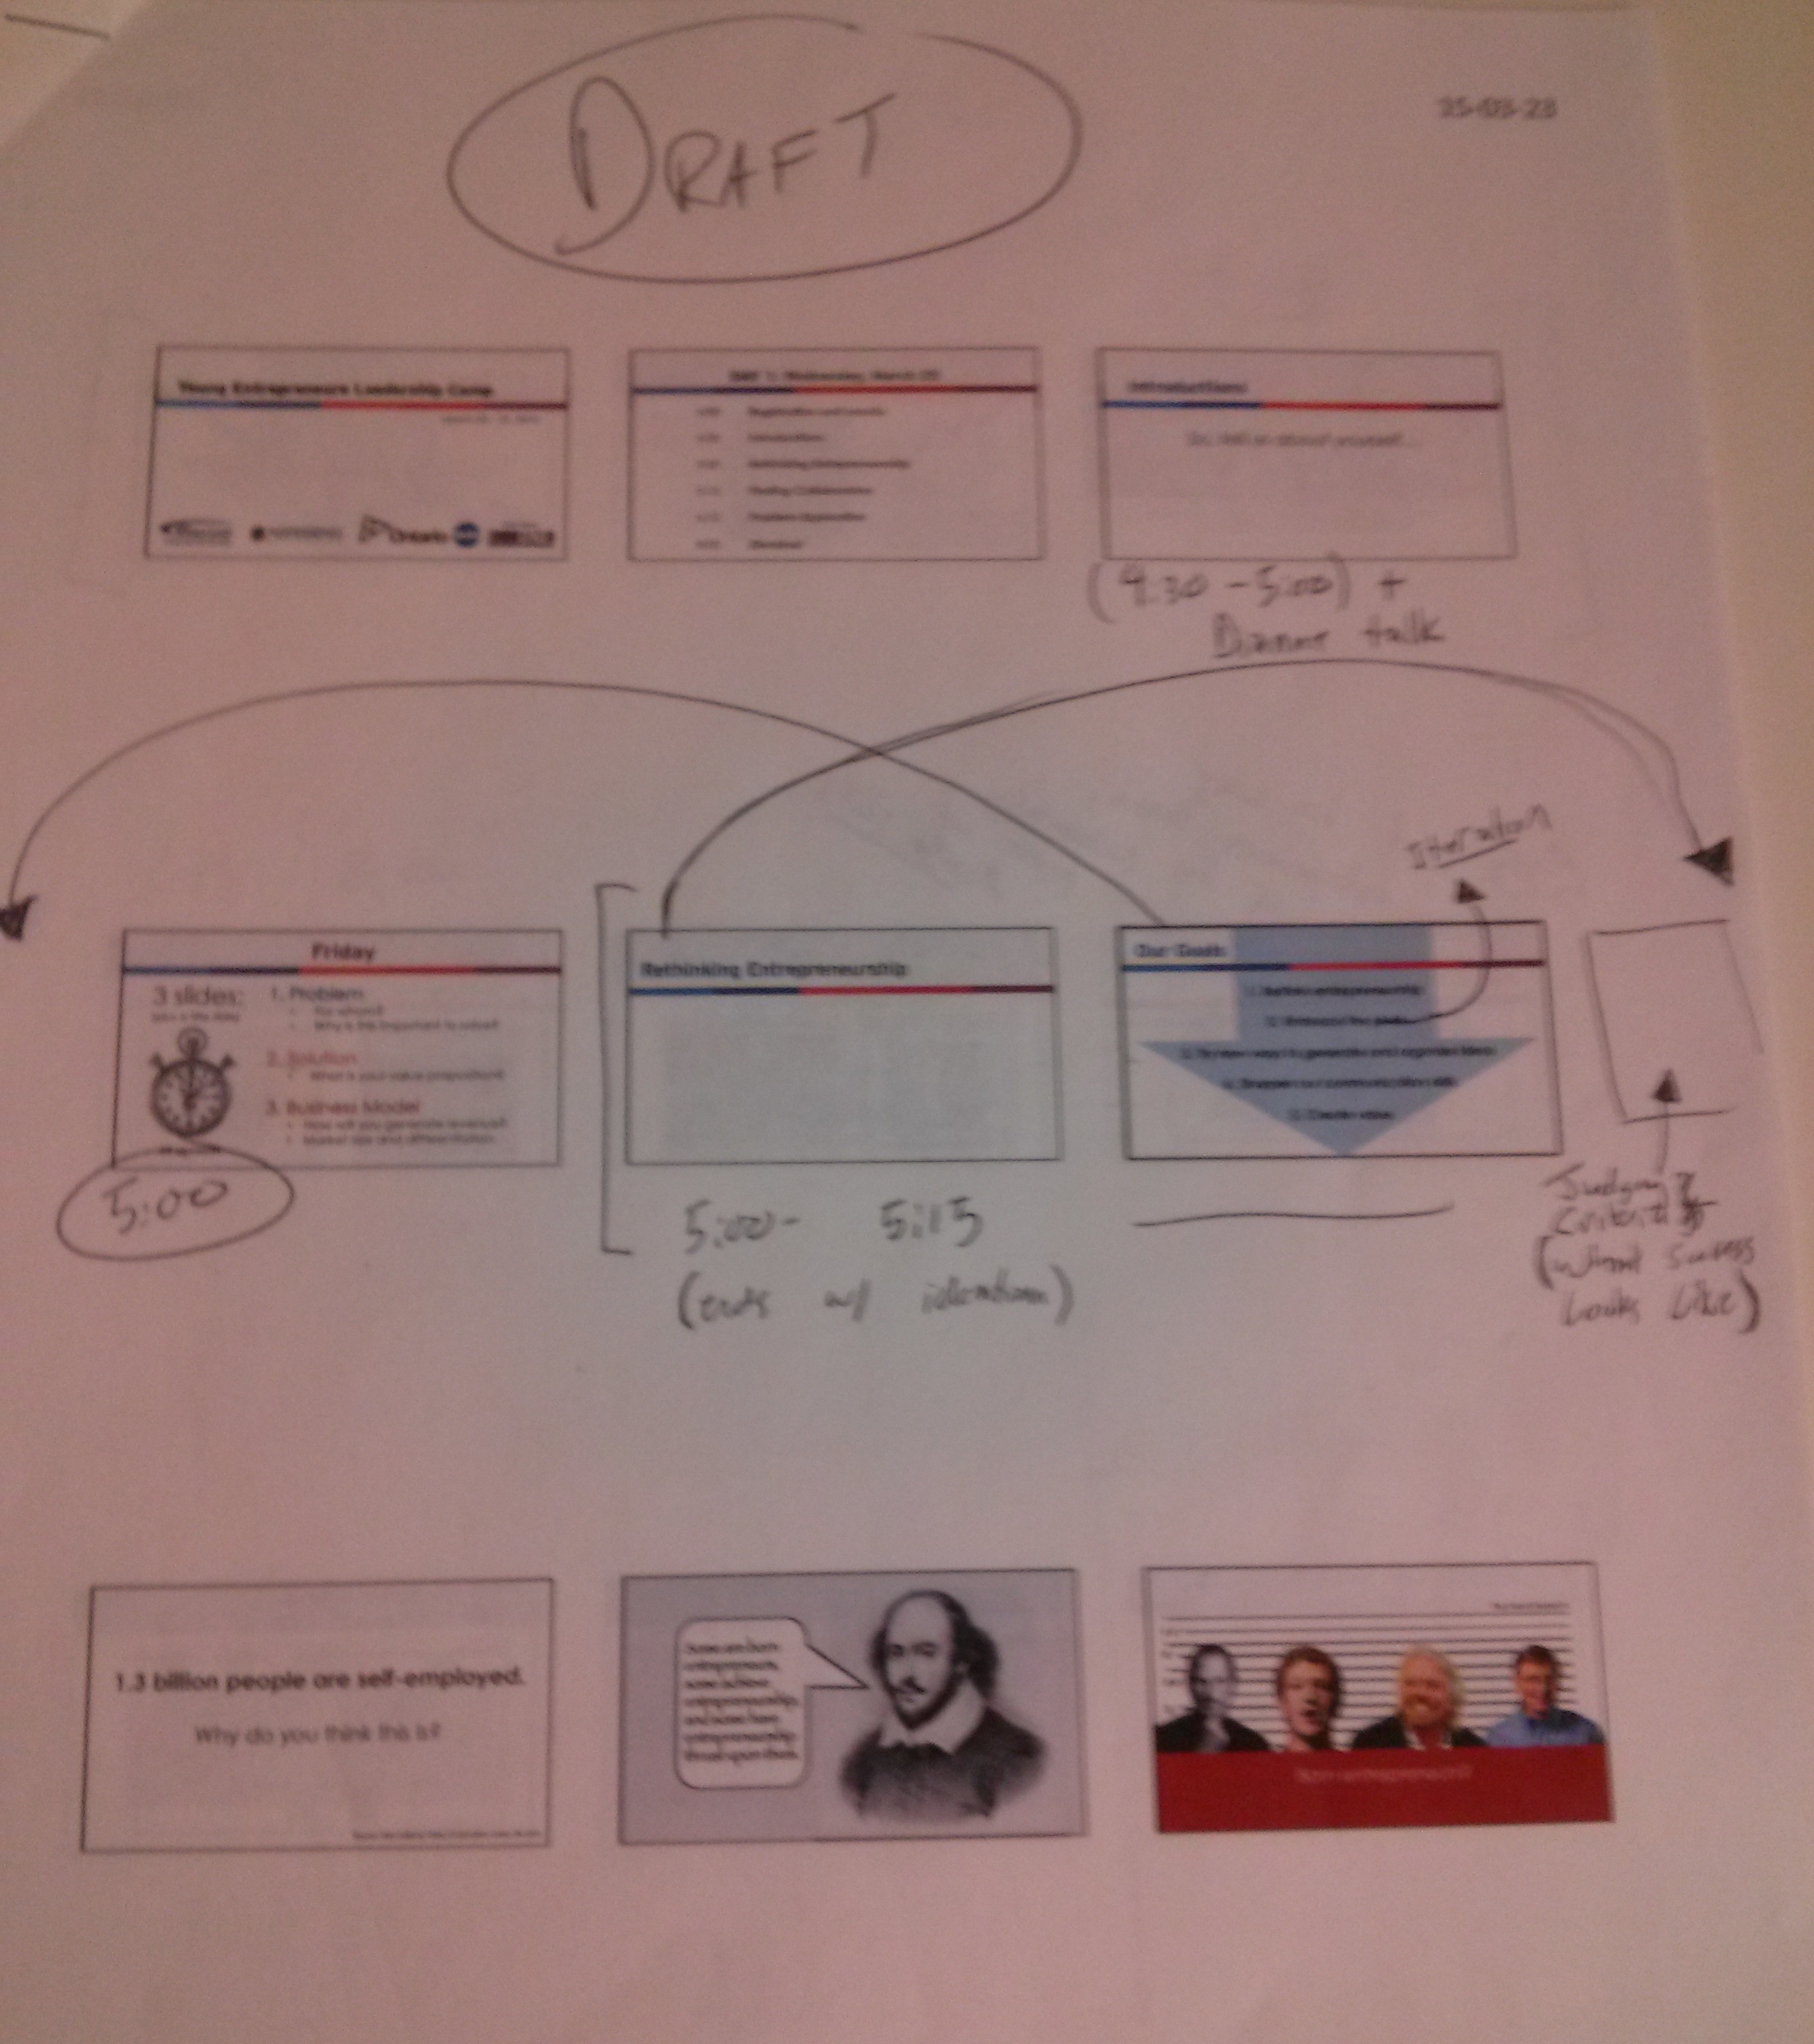
Prototyping Presentations & Pitches
What does your user want to accomplish?
What key features do they need to accomplish this?
How will users interact with this solution?
#greenHACK

Slide 66
Business Model Basics
#greenHACK
Notes:
9:30

Slide 67
A business model describes how your company will generate revenue.
#greenHACK
Notes:
Activity time: 60 minutes
2:00-3:00

Slide 68



How do they make money?
Product & Service
Sales
Subscription to a Service
Ad Revenue
#greenHACK

Slide 69


How do they make money?
Commission
Freemium
#greenHACK

Slide 70
A business model describes how your company will generate revenue.
Creating your business model starts with having a clear understanding of the value you provide.
#greenHACK
Notes:
Activity time: 60 minutes
2:00-3:00

Slide 71
Value Proposition:
A 1 – 2 sentence statement that describes:
What your product/service is
Who your customers are
Why it’s valuable to these customers
#greenHACK
Notes:
Activity time: 60 minutes
2:00-3:00

Slide 72
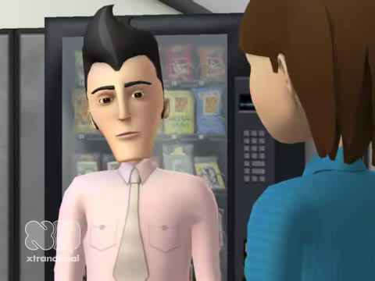
A Cautionary Example:
Notes:
A cautionary example.

Slide 73
What he meant to say:
A1 Industries has developed an economical and easy-to-use chemical additive that allows paint manufacturing companies to reduce the environmental impact of their products.
#greenHACK

Slide 74
What he meant to say:
A1 Industries has developed an economical and easy-to-use chemical additive that allows paint manufacturing companies to reduce the environmental impact of their products.
What is it?
Who is it for?
Why is it valuable?

Slide 75
What’s your value prop?
What is it?
For whom?
Value?
Practice & refine it during the networking reception!
#greenHACK
Notes:
Before going to the next slide, get students to pick the value prop they believe is most effective – and have them justify WHY they believe this

Slide 76
Tomorrow:
12:30 Lunch
1:00 Open-ended Design and Prep Time
3:30pm – PITCH COMPETITION
5:00 – Bus departs Kempenfelt
7:30 – 9:00 Breakfast
9:00 Open-ended Design and Prep Time
10:00 Business Model Canvas (opt-in workshop)
11:00 Pitch Techniques
#greenHACK

Slide 77
Key Activities
Customer Relationships
Customer Segments
Key Partners
What external partnerships should you invest in?
Mentors?
Lawyers?
Distributors?
Suppliers?
What will your business spend most time doing?
Product development?
Sales? Other?
What types of interactions will your customers expect to have with you?
Who are your paying customers?
Do you have any non-paying customers?
How large is this group?
Do you have multiple customer segments?
Value Proposition
Key Resources
Channels
How will customers find out about you?
How will you get products to them?
What will it cost for:
Manufacturing?
Intellectual Property?
Human Resources?
Cost Structure
Revenue Streams
How might you make $ from this?
What value, other than money, are you hoping to create?
How much time and money will be required to do this?

Slide 78
3:30 - Pitch Competition
1. Problem
Who, specifically, is affected?
Why is this important to solve?
2. Solution
Meets needs of a specific audience
Creatively visualized with a prototype
3. Business Model
Clear, compelling value proposition
Viable and sustainable
2 minutes to pitch
+
3 minutes for questions

